Slide 1
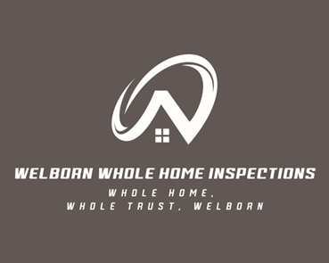
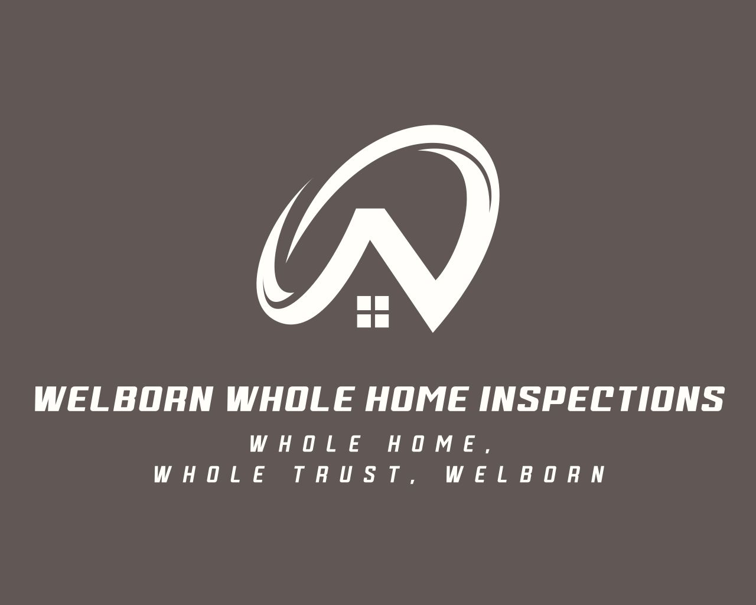
Contact Us
Client-Focused Approach
Our service is centered around the needs of our clients, with a focus on open communication and clear reporting to support you during the home buying or selling process. When you choose us, we are happy to discuss our findings and answer any questions you may have about your property or prospective property.
Welborn Whole Home Inspections
📞 850-625-3460
✉ welbornwholehomeinspections@gmail.com
🌐 welbornwholehomeinspections.com
Licensed & Insured in Alabama & Florida
Member of ASHI
Certified Drone Pilot
Call or Book Online!
Seller’s Pre-Inspection Checklist:
A quick guide to help your home shine during inspection
Inside: Pre-Inspection Checklist
[Insert Logo Here]

Slide 2
Before the Inspector Arrives
General Maintenance
Electrical | Plumbing |HVAC
• Turn on all utilities (electric, gas, water).
• Clear access to attic, crawl space, electrical panel, HVAC, and water heater.
• Unlock gates, garages, and outbuildings
• Replace burned-out bulbs & missing outlet covers.
• Clean rooms & remove clutter.
• Tighten loose handles & hinges.
• Test all windows & locks; repair torn screens.
• Fix leaks under sinks & around toilets.
• Replace dirty HVAC filters.
• Test smoke & CO detectors
• Test outlets, switches & GFCIs.
• Label breaker circuits if needed.
• Check that toilets flush, don’t run continuously, and that the base isn’t loose/wobbly
• Check water pressure & drains.
• Fix faucet or pipe leaks.
• Correct any reverse-plumbed fixtures (hot and cold water lines connected backward-the right should run cold and the left should run hot)
• Test heating/cooling systems
• Schedule HVAC tune-up if over 1 year since last service.
Bonus Tips
• Leave notes if something is off (e.g., winterized plumbing).
• Gather repair receipts or warranties.
• Plan for the inspection to take 3–4 hours
Roof & Attic
• Replace missing or damaged shingles.
• Check flashing at chimneys & vents.
• Clean gutters & confirm proper drainage.
• Inspect fascia/soffits for rot or gaps.
• Look in attic for stains, daylight, or mold.
• Ensure insulation is dry & ventilation open.
• Provide buyers with documentation of roof age, repairs, or warranty if available.
•If roof is over 15 years old, consider a roof inspection or certification from a roofer
Why Schedule a Home Inspection?
Exterior & Grounds
Regular inspections help identify small issues before they become costly repairs.
Whether buying, selling, or maintaining your home, a professional inspection gives peace of mind and helps protect your investment.
Bonus Tips:
• Keep a maintenance log.
• Don’t skip seasonal tasks.
• If you plan on selling your house, ask your agent about pre-listing inspections.
• Clean gutters; ensure downspouts drain away.
• Seal gaps around windows, doors, and trim.
• Repair/replace sections of siding if there is damage or holes.
• Test garage door & safety reverse.
• Trim plants off siding & roof.
• Clear debris near foundation.
• Check grading-soil should slope away from house

